Slide 1
Automaticity of Musical Processing
Danielle DeVincentis, Melissa Poole, and Zach Reed
Hanover College

Slide 2
Introduction
The Stroop Effect (Stroop, 1938)
Automaticity of Movement (Solso, 2008)
Similar effect when playing instrument
Can musical literacy become automatic?

Slide 3
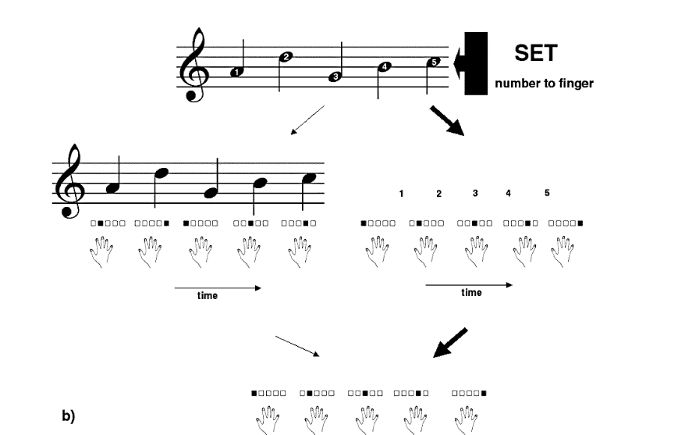
Previous Research
Irrelevant musical notation causes Stroop effect (Stewart, 2005)

Slide 4
Previous Research, Cont.
Incongruence between auditory and visual stimuli leads to inaccuracy (Wöllner, Halfpenny, Ho, & Kurosawa, 2003).

Slide 5
Hypothesis
When presented with incongruent visual and auditory stimuli, participants who were music-literate would:
have slower reaction times.
be less accurate than participants who could not read music.

Slide 6
Method
Participants
N=38
17 male, 21 female
18-22 years old, with one 53 year old outlier
38 Caucasian
25 could read music, 13 could not.

Slide 7
Stimuli
6 simple tunes
“Mary Had A Little Lamb”, “Frere Jacques”, “Jesus Loves Me”, “Ode to Joy”, “Yankee Doodle”, or “Twinkle, Twinkle, Little Star.”
Musical staff with congruent or incongruent notes

Slide 8
Equipment
Gateway Model FPD1565 LCD Monitor
Gateway Model E4300 Computer
Headphones
Demographic Survey
Java Program (Krantz, 2010)

Slide 9
Procedure
Within-Subjects design
25 trials per condition
After participants completed one condition, researchers prepared the computer for the next condition
Indicate tune being played
Recorded average reaction time and accuracy for each condition

Slide 10
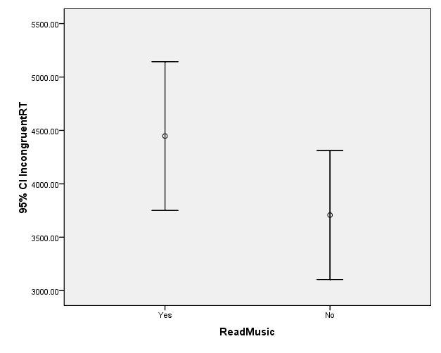
Results

Slide 11
Discussion
Too much error to make conclusions
Not a problem in traditional Stroop.

Slide 12
Possible Explanation
Continuum of Automaticity (MacLeod & Dunbar, 1988)
Variance in level of training or ability causes varying levels of automaticity.

Slide 13
Future Directions
Faster reaction task
Interactive visual stimuli (Stewart, Walsh, & Frith, 2004; Stewart, 2005)
Association between musical notation and physical actions (Stewart, Walsh &, Frith, 2004)
Phonological loop for music reading?

Slide 14
Questions?

